Slide 1
Data Centers Are a ‘Gold Rush’ for Construction Workers
Ed Elowson
Week 3

Slide 2
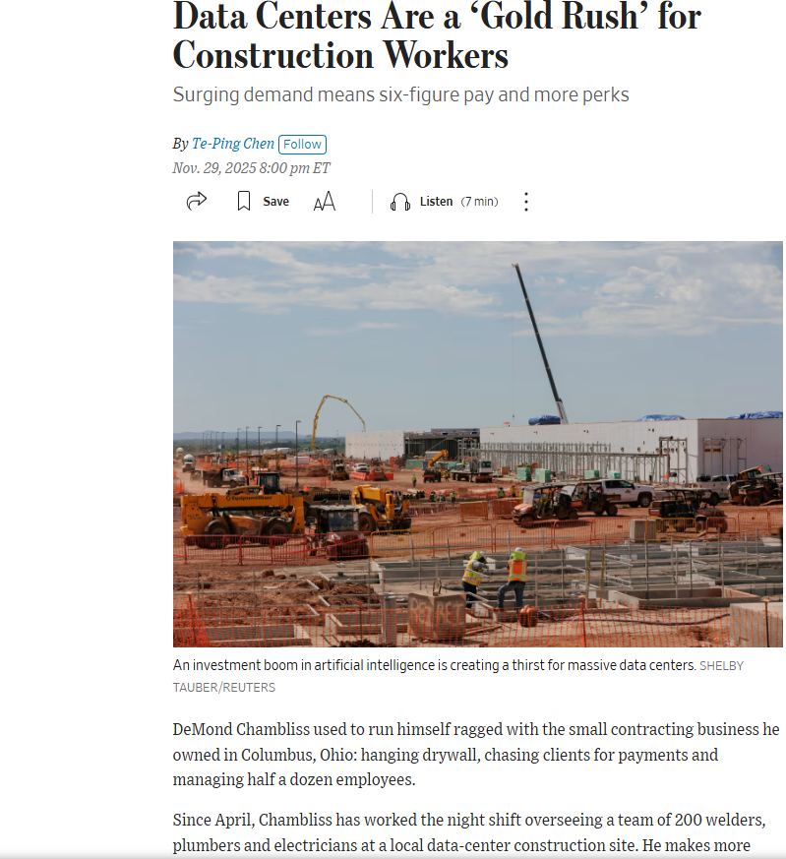
Article Screenshot

Slide 3
Link to Source
https://www.wsj.com/business/data-centers-are-a-gold-rush-for-construction-workers-6e3c5ce0?reflink=desktopwebshare_permalink

Slide 4
Main Findings and Arguments
The article argues that the rapid growth of artificial intelligence is driving a massive boom in data-center construction, which is creating unusually high demand for skilled construction workers.
Key findings include:
Major tech companies such as Amazon, Google, and Microsoft are building hundreds of data centers to power AI systems.
These projects require large construction crews, sometimes thousands of workers, because the facilities involve complex infrastructure like electrical systems, cooling equipment, generators, and reinforced structures.
Due to high demand, many workers are earning 25–30% more than typical construction jobs, with some supervisors and specialists making over $200,000 per year.
The construction industry already faces a shortage of about 439,000 workers, which intensifies competition for skilled trades such as electricians, welders, and plumbers.
Construction companies are offering bonuses, perks, and better working conditions to attract workers.
Overall, the article describes the situation as similar to a “gold rush,” where workers with the right skills can quickly earn high wages due to booming demand.

Slide 5
Broader Implications for Society
The boom in data-center construction reflects a larger technological shift driven by the growth of AI infrastructure.
Major societal implications include:
Economic opportunities for skilled trades: Workers without college degrees can earn high incomes through technical construction jobs.
Regional economic growth: Areas with many data centers—like parts of Virginia—are seeing increased employment and training programs.
Workforce migration: Workers are traveling long distances or relocating to follow these projects.
Training expansion: Trade unions and apprenticeship programs are growing because more people are entering skilled trades.
Uncertain long-term stability: The article notes that it is unclear how long the AI investment boom will last, which could affect job stability in the future.
In broader terms, the AI industry is not only affecting technology jobs but also creating ripple effects across many sectors of the economy.

Slide 6
Relevance or Potential Influence on the Construction Industry
The AI data-center boom could significantly reshape the construction industry.
Important impacts include:
Increased demand for specialized construction skills, especially electrical work, cooling systems, and large-scale industrial building.
Higher wages and improved benefits as companies compete for limited skilled labor.
Project backlogs and delays due to labor shortages.
More focus on large industrial infrastructure projects, especially data centers and AI-related facilities.
Greater stability for workers, as many projects last several years and provide steady employment.
In the long term, the article suggests that AI infrastructure may become one of the most important drivers of construction activity, similar to how highways, factories, or office buildings fueled past construction booms.

